Slide 1

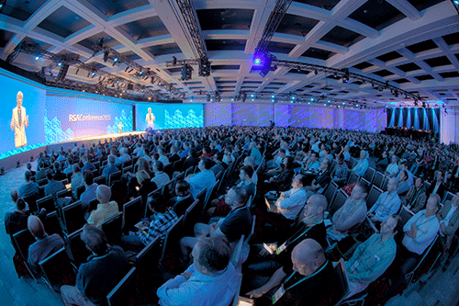
RSA Encryption
Company ( beg.1982)
Conference (yearly)
Student: Bujor Tiberiu-Cosmin
Assistant professor: Dijana Capeska Bogatinoska, Ph.D.
Teaching assistant: Aleksandar Karadimce, MSc

Slide 2

Table of Contents
What is RSA?
How does it work?
Implementation
When to use RSA?
Conclusions

Slide 3
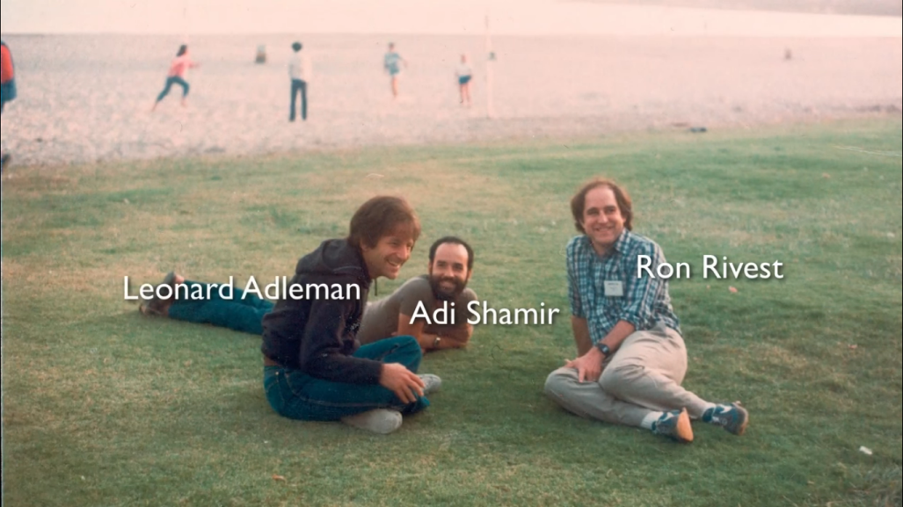
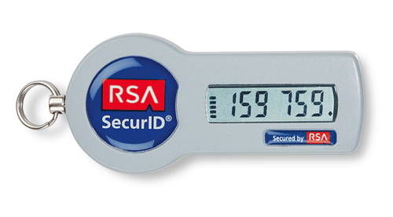
What is RSA?
RSA is the first work-able and practical public-key cryptographic system, invented in 1977 and published in 1978, by Rivest, Shamir and Adleman. (professors at MIT)
Is the best public cryptanalysis system, yet.
In 1982 Rivest, Shamir and Adleman begun the company that maintains the RSA BSAFE cryptography libraries and the SecurID authentication token. The company organizes the annual conference.

Slide 4
What is RSA?
Certifications : PKCS#1, ANSI X9.31, IEEE 1363
The algorithm was released to the public domain by RSA Security on September 6, 2000 after the term of patent (17 years at the time) expired.
The creators of the RSA cryptographic system received the 2002 Turing Award, a prize considered to be the equivalent Nobel Prize for Computer Science.
RSA is a relatively slow algorithm, and because of this it is less commonly used to directly encrypt user data.
Key sizes: 1,024 to 4,096 bit
A 768-bit key has been broken using Shor's algorithm for quantum computers

Slide 5
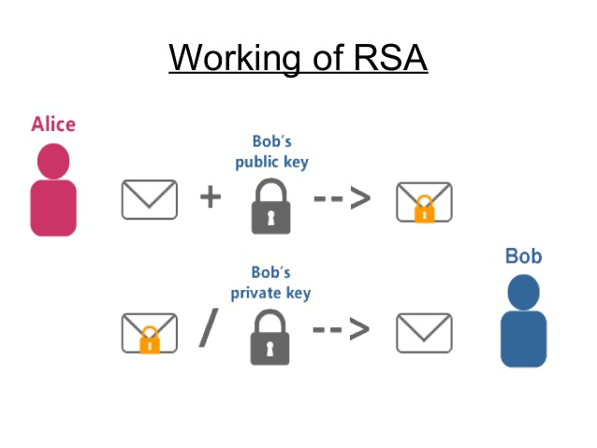
How does it work?
A user of RSA creates and then publishes a public key based on two large prime numbers, along with an auxiliary value.
The prime numbers must be kept secret. Anyone can use the public key to encrypt a message, but with currently published methods, if the public key is large enough, only someone with knowledge of the prime numbers can feasibly decode the message.

Slide 6
How does it work?
The RSA algorithm involves four steps: key generation, key distribution, encryption and decryption.
The security of any public-key cryptosystems relies, in one way or another, on the intractability of some sort of number-theoretic problems, or more generally mathematical problems such as problems in arithmetic algebraic geometry.
RSA involves a public key and a private key.
The public key can be known by everyone and is used for encrypting messages.
The private key is known just by the person who wants to receive messages using the public key.

Slide 7
How does it work?
Key generation:
Choose two distinct prime numbers p and q. (>155 digits and chosen at Random)
floor(log_10(2^1024)) + 1 = 309 (digits in 1024 bits)
Compute n = p*q. (key length)
Compute λ = (p − 1)*(q − 1), where λ is Carmichael's totient function. This value is kept private.
Choose an integer e such that 1 < e < λ(n) and
gcd(e, λ(n)) = 1, e and λ(n) are co-prime.
Determine d as d ≡ e^(-1) (mod λ(n))
d is kept as the private key exponent.
The public key consists of the modulus n and the public (or encryption) exponent e.
The private key consists of the modulus n and the private (or decryption) exponent d, which must be kept secret.
p, q, and λ(n) must also be kept secret because they can be used to calculate d.

Slide 8
How does it work?
Key distribution
Suppose that Bob wants to send a secret message to Alice. If they decide to use RSA, Bob must know Alice's public key to encrypt the message and, Alice must use her private key to decrypt the message. To enable Bob to send his encrypted messages, Alice transmits her public key (n, e) to Bob via a reliable, but not necessarily secret route. Alice's private key (d), is never distributed.
Encryption
After Bob obtains Alice's public key, he can send a message M to Alice.
To do it, he first turns M (strictly speaking, the un-padded plaintext) into an integer m (strictly speaking, the padded plaintext), such that 0 ≤ m < n by using an agreed-upon reversible protocol known as a padding scheme. He then computes the ciphertext c, using Alice's public key e, corresponding to c = m^e (mod n).
Decryption
Alice can recover m from c by using her private key exponent d by computing c^{d} ≡ m^{ed} ≡ m (mod n).
Given m, she can recover the original message M by reversing the padding scheme.

Slide 9
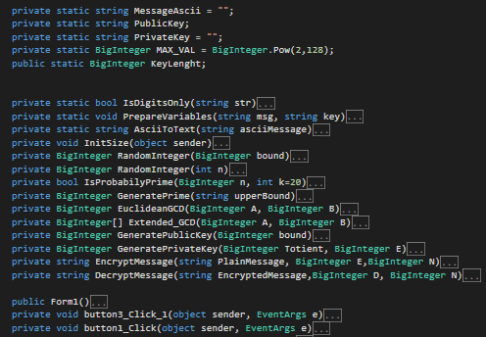
Implementation
All procedures in a picture ☺

Slide 10
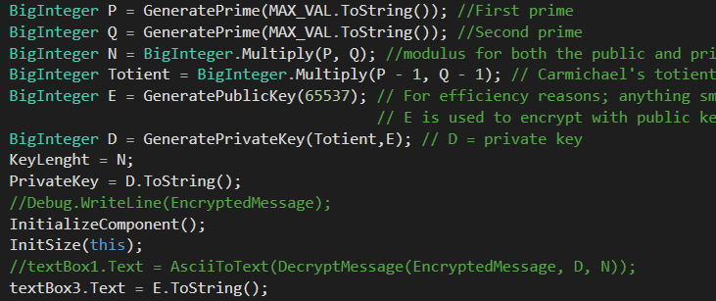
Implementation
Key generation using the BigInteger type.
BigInteger is a special type that can hold numbers to simulate infinity.

Slide 11
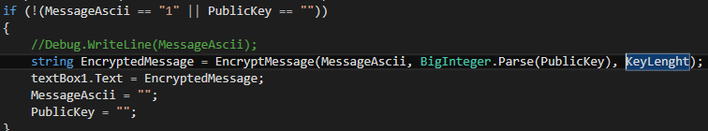
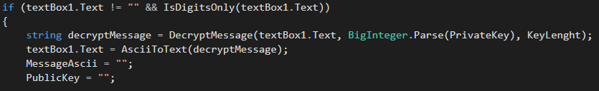
Implementation
Encryption
DEcryption

Slide 12
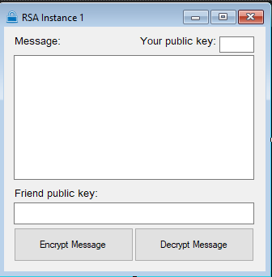
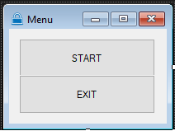
Implementation
2

Slide 13
When to use RSA?
RSA is used mostly in hybrid encryption schemes and digital signatures because encryption/decryption process is slow and more secure.
It’s easier to encrypt a symmetric key and send it to a second party who the connection must be made with and then use the symmetric encryption algorithm to communicate.
For Digital signatures one can use the private key to sign a message or file (or better: sign the cryptographic hash of the message/file, much faster). If a second party has the corresponding public key he can verify that the file is authentic and has not been altered or damaged.
Public/Private key crypto is used in a wide variety of protocols and data formats, which are implemented by a huge range of application and system software:
SSL (https) protocol
SSH (secure remote login, tunneling, etc)
Digitally signed PDF files (including attachments within the PDF)
Signed Applets and jar archive files for Java
Digital signatures in the packaging infrastructure for Debian, Ubuntu and Red Hat Linux distributions, etc.

Slide 14
Conclusions
RSA is the most secure public-key cryptosystem
It’s a bad practice to rely only on RSA as a way of encryption because the messages need to be small and the processing power required is bigger than the average computer can handle.
RSA falls in a different category of encryption algorithms (asymmetrical) and should not be used to replace AES(symmetrical), SHA(hash based), etc. Use them together or don’t use RSA at all.
As of 2010, the largest factored RSA number was 768 bits long and was done in two years of real time, on many hundreds of computers. Because of this it is preferred to use 2048 bits.

Slide 15
References:
Rivest, R.; Shamir, A.; Adleman, L. (February 1978). "A Method for Obtaining Digital Signatures and Public-Key Cryptosystems“
Calderbank, Michael (2007-08-20). "The RSA Cryptosystem: History, Algorithm, Primes“
Cryptanalytic Attacks on RSA By Song Y. Yan University of Bedfordshire, UK And Massachusetts Institute of Technology, USA
Diffie, W.; Hellman, M.E. (November 1976). "New directions in cryptography“
Jim Sauerberg "From Private to Public Key Ciphers in Three Easy Steps“
Surender R Chiluka. "Public key Cryptography".

